Slide 1
Fitness Activity Recognition
Fifth Week: 13 August to 19 August

Slide 2
Agenda
Angle-Invariance:
Algorithm-1
Algorithm-2.1
Algorithm-2.2: with cube normalization
Goals for next week
Q&A

Slide 3
Angle Invariance

Slide 4
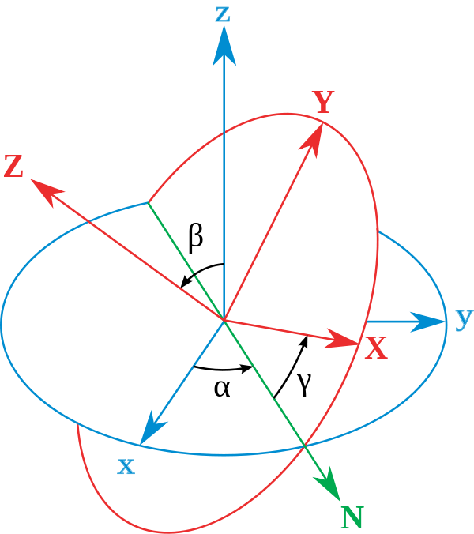
Algorithm 1
Extract 3D coordinates using Mediapipe Blazepose
Rotate the coordinates by a certain angle using Euler’s Rotation Matrix about y-axis
Compare the rotated set using the previous algorithms using DTW

Slide 5
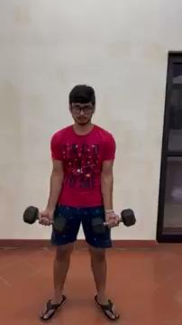
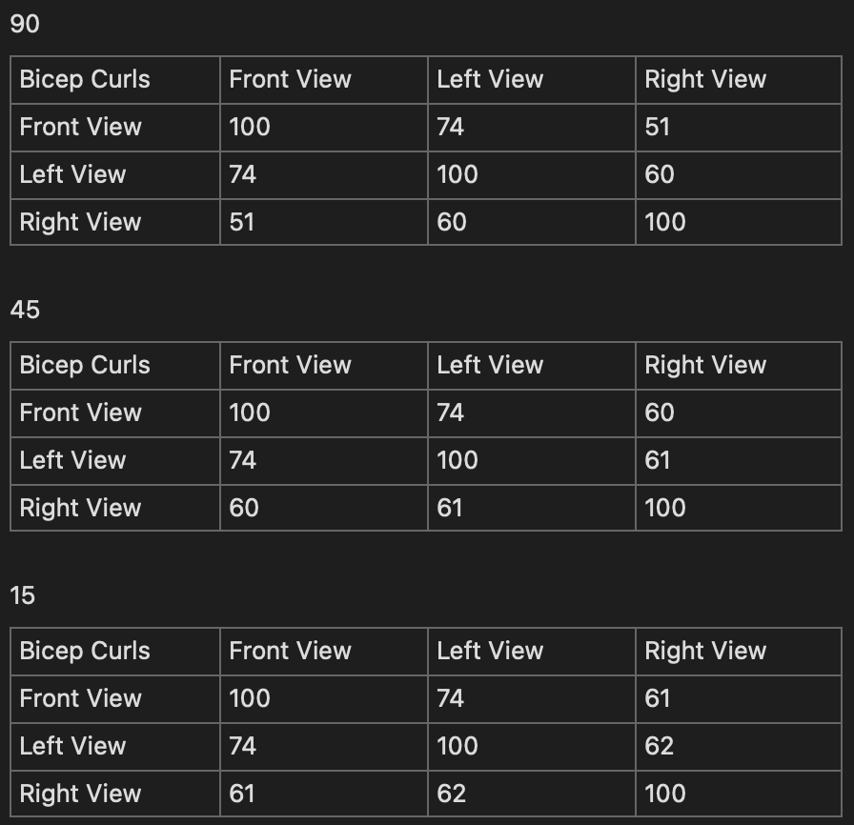
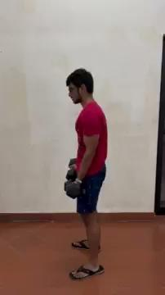
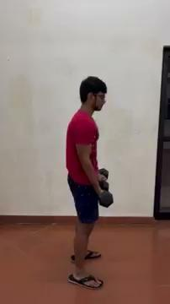
Algorithm 1: Results

Slide 6
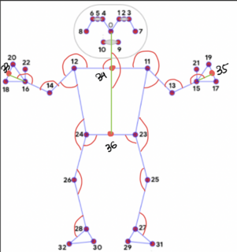
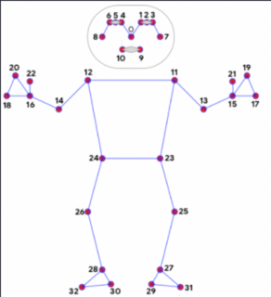
Algorithm 2.1
Extract 3D coordinates using Mediapipe Blazepose
Add 4 new key-points: Neck, left-right hand, middle pelvis
Extract 18 important angles from the 3D coordinates
Compare arrays of angles per frame using DTW

Slide 7
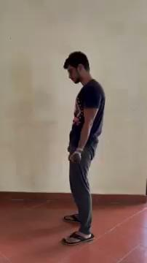
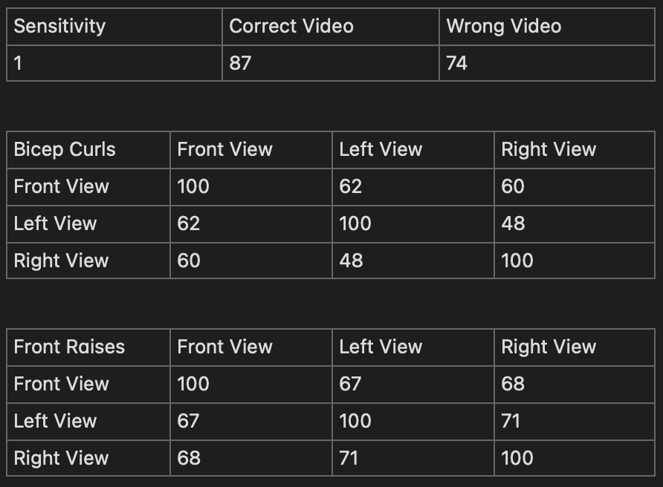
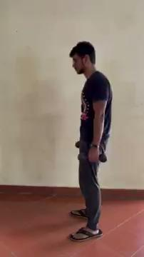
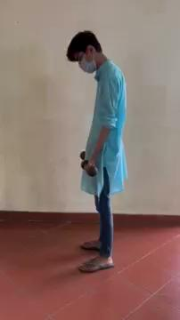
Algorithm 2.1: Results

Slide 8
Algorithm 2.2: with cube normalization
Same as Algorithm 2, with added cube normalization
Each frame is squeezed into unit cube using the mapping: x -> (x - x_min)/(x_max - x_min) for each coordinate
Origin at (x_min, y_min, z_min)
Seems like the best algorithm

Slide 9
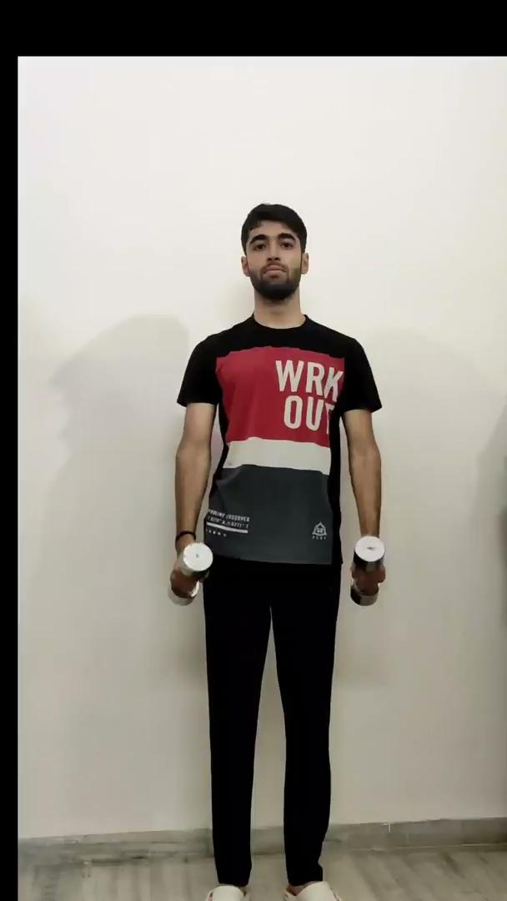
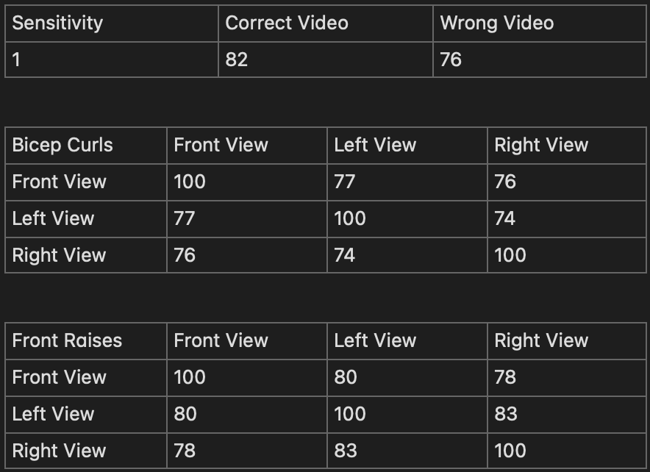
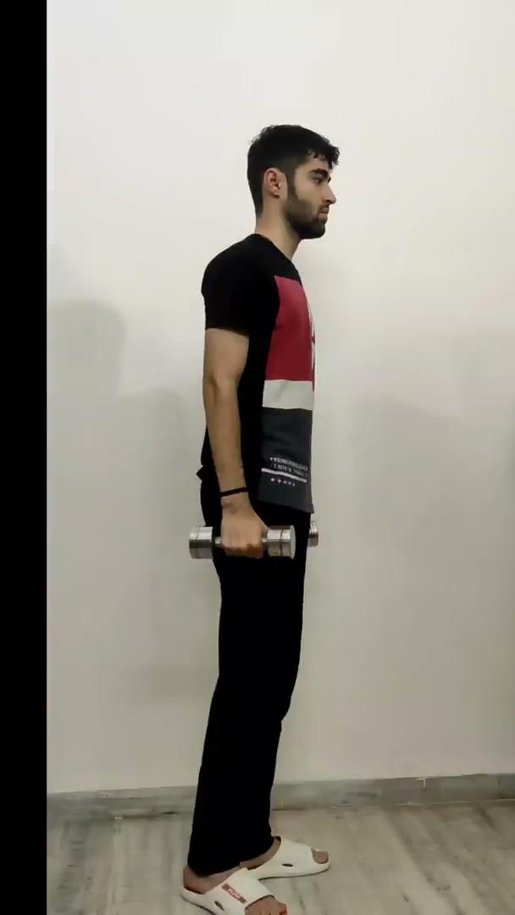

Algorithm 2.2: Results
On non-vanilla Data:
Correct Form: 76
Incorrect Form: 73

Slide 10
Goals for next week
Algorithm 2.2 seems the best? verify by testing on more videos
Create and add visualizations to view angles between key-points
Perform more tests on different exercises
Test on non-vanilla datasets
Optimise the suggested algorithms (using C implementation of DTW)
Test the removal of key-points absent in video

Slide 11
Q & A

